Slide 1
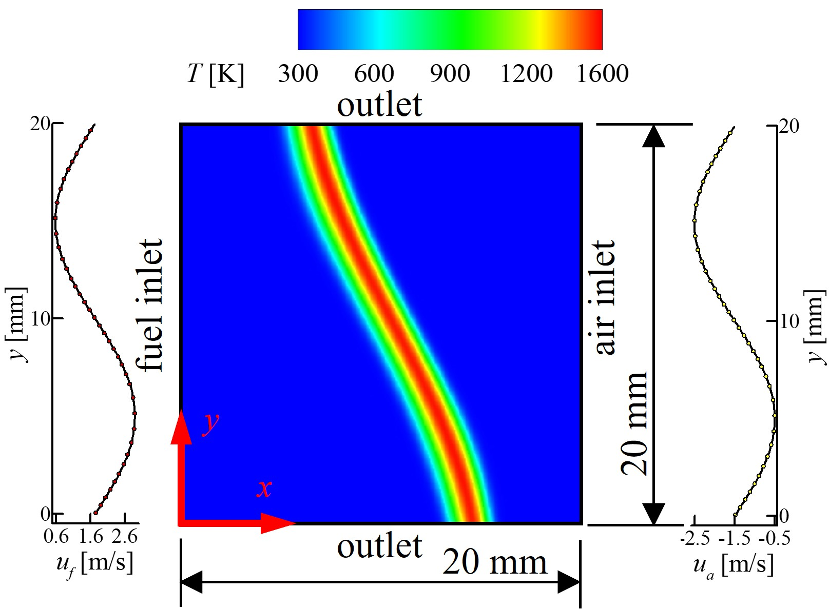
Bachelor Thesis
Impact of nozzle separation distance to diameter ratio on the 1D flamelet assumption
At what L/D ratio, the 2D counter flow flames behave like1D counter flow flames at different strain rates?
  Impact of differential diffusion
  Impact of strain rates
flame
Air nozzle
D
Fuel nozzle
L
Schematic of configuration
Impact of geometry shape planar to axis-symmetric on hydrogen counter-flow flames
Impact on flame curvature
Variation of local strain rate from inlet strain rate
Extinction limits (local strain rate)
Flamelet assumption
outlet
air
fuel
Contact Person:
Prashant Shrtoriya
prashant.shrotriya@kit.edu
KIT Campus Süd
Geb. 10.91, Raum 216
symmetry
Computational domain for planar case
Computational domain for axis-symmetric case

Slide 2
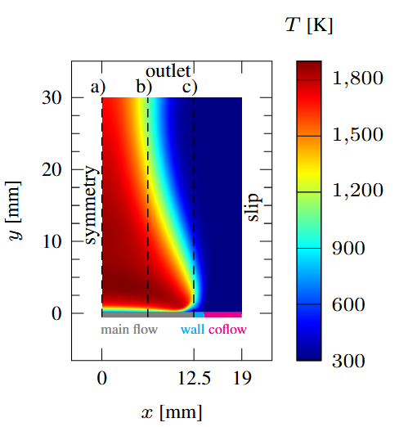
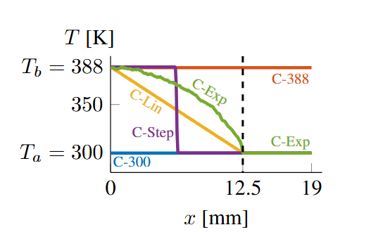
Master Thesis
Sensitivity of burner-stabilised flame with reaction rate coefficients with burner surface temperature inhomogeneity
  Supervisors – Philipp Golda and Prashant Shrotriya
Motivation
  For experiments, it’s important to know whether temperature/coflow velocity is more critical or the rate coefficients of some important reactions
Observations noted till now
  Frequency of flame oscillations in 2D was same as in 1D for the same inlet temperature.
  Spatial variation of temperature didn’t affect the frequency; however, maximum temperature of burner surface governed the frequency of flame oscillations.
Questions to be answered
  Quantification of sensitivity of flame oscillation with temperature versus reaction rate coefficients.
  Impact of different flame markers used for calculations of frequency.
Contact Person:
Prashant Shrtoriya
prashant.shrotriya@kit.edu
KIT Campus Süd
Geb. 10.91, Raum 216
Computational domain^{[5]}
Different temperature profiles considered at inlet

